Slide 1



Shasta Coordinated
Transportation Plan
SSTAC Workshop #3
01/24/2023

Slide 2
Project Team
Shasta Regional Transportation Agency
  Keith Williams, Senior Transportation Planner, AICP
  Laurent Beauregard, Assistant Transportation Planner
LSC Transportation Consultants
  Justine Marmesh, Senior Transportation Planner, AICP
  Genevieve Evans, Associate Transportation Planner, AICP
  Claire Hutchinson, Transportation Planner
AIM Consulting
  Katie Demaio, Project Manager

Slide 3
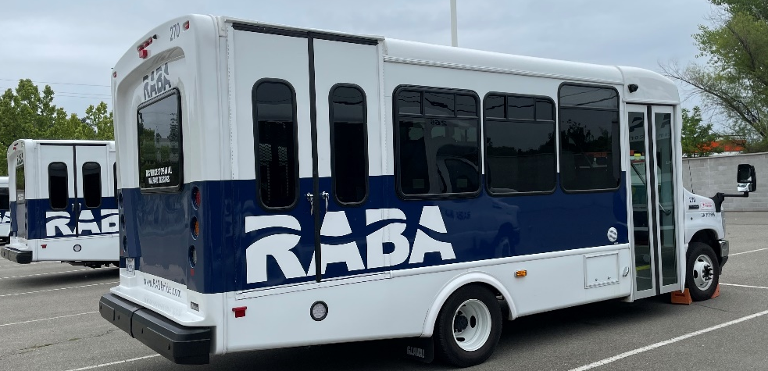
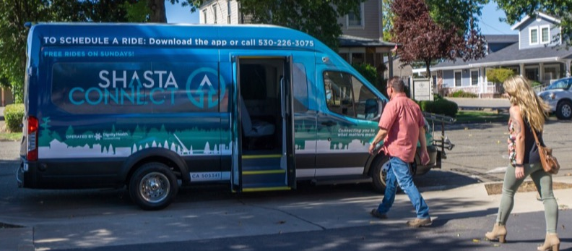
Recent Project Progress
Technical Memorandum 3 completed in December
  Needs Assessment
  Coordination Goals and Objectives
  Recommended Strategies
  Implementation Plan
Draft 2024 Shasta Coordinated Plan
  SRTA and SSTAC review in Progress
Need-A-Ride Guide Update

Slide 4
Strategic Coordination Categories
I. Increase Cooperation and Coordination Among Transportation Providers
II. Enhance or Expand Transportation Services
III. Maintain Existing Access to Transportation Services
IV. Increase Public Awareness of Available Transportation Resources

Slide 5
2024 Recommended Strategies
Strategy 1: Improve Regional Organizational Coordination
Strategy 2: Minimize Duplication of Operational and Administrative Functions
Strategy 3: Implement Technological Improvements
Strategy 4: Invest in Infrastructure and Capital Improvements
Strategy 5: Improve Access to Transportation for Residents in Need
Strategy 6: Maintain Current Level of Transportation Services
Strategy 7: Expand Outreach and Regional Education of Services

Slide 6
Strategy 1: Improve Regional
Organizational Coordination
1.1 Designate Mobility Manager position under RABA and ensure Mobility Manager consults with SSTAC and informs regional transit.
1.2 Create and maintain an email listserv that includes contact information for a variety of organizations that represents seniors, disabled, and low-income residents to inform the community about transportation updates and ongoing planning efforts.
1.3 Create consistent regional driver recruitment, development, screening, and training standards.
1.4 Share program updates and changes with other regional providers (Examples: hours, routes, programs, grant eligibility, etc.).
1.5 Include regional service and demographic representatives (low-income service agencies, tribal organizations, etc.) in the SSTAC and other transportation planning efforts through regular, ongoing outreach.

Slide 7
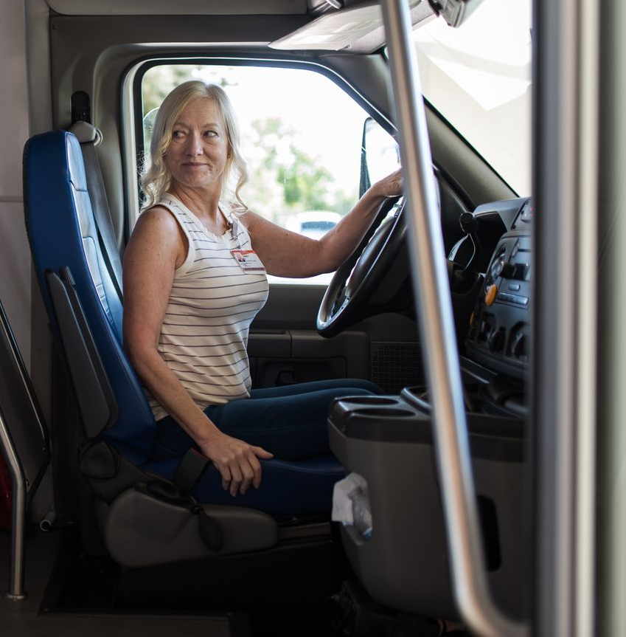
Strategy 2: Minimize Duplication of Operational and Administrative Functions
2.1 Consolidate RABA and ShastaConnect services under one organizational lead.
2.2 Research and make progress towards resource sharing between agencies. (Examples: drivers, maintenance agreements, vehicles).

Slide 8

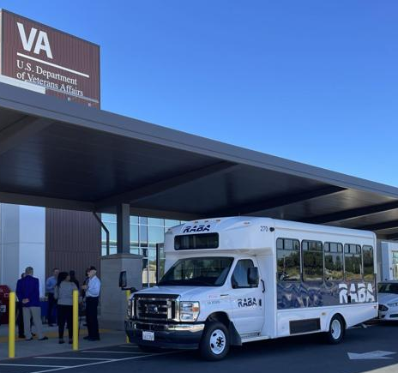
Strategy 3: Implement Technological Improvements
3.1 Research relevant app-based trip-planning programs and issue an RFP for development.
Strategy 4: Invest in Infrastructure and Capital Improvements
4.1 Install bus shelters, benches, signage, lighting, and security improvements to improve the passenger experience.
4.2 Procure new or replacement vehicles when able, including alternative-fueled vehicles.

Slide 9
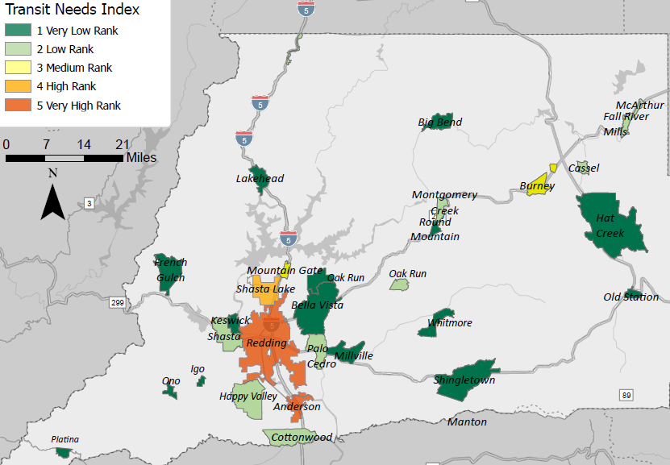
Strategy 5: Improve Access to Transportation for Residents in Need
5.1 Develop and implement standardized Affordable Fare Programs.
5.2 Expand existing RABA Travel Training Program.
5.3 Develop Volunteer Driver Reimbursement Program.
5.4 Support RABA in implementing new rural service options.

Slide 10
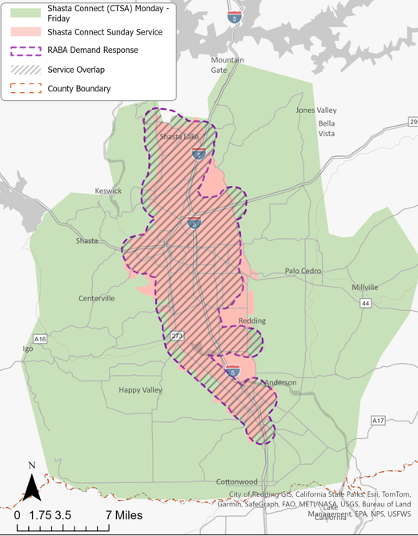
Strategy 6: Maintain Current Level of Transportation Services
6.1 Apply for grants for transportation services (Section 5310, FTA Low or No Emission grants, etc.).
6.2 Complete vehicle and facility projects as outlined in the RABA and SRTA ZEB Rollout Plans.

Slide 11
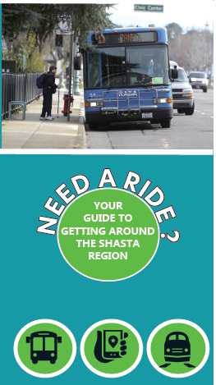
Strategy 7: Expand Outreach and Regional Education of Services
7.1 Explore opportunities to consolidate all regional public transit providers under one brand.
7.2 Maintain database of transportation service providers and update Need-A-Ride Guide.
7.3 Develop marketing materials to inform public of available NEMT services.

Slide 12

Strategy Discussion
What strategies really stand out to you?
What challenges do you see in implementing these strategies?
What else would you like to know?

Slide 13


Implementation Discussion
Reviewing Table 15: Shasta Coordinated Transportation Plan - Implementation Plan
Are there any strategies where the implementation timeline seems unreasonable to meet?
What else should we consider?

Slide 14
Need-A-Ride Guide Update
Existing Need-A-Ride Guide content was extracted and reviewed for accuracy.
An initial redesign and color update was implemented throughout the brochure.
SRTA reviewed and provided comments to LSC to implement.
Draft Guide will be distributed in February for review and comment by SSTAC before the final guide is prepared for printing and distribution.
Where would you like to see the Need-A-Ride Guide available in the community?

Slide 15
Thank you!
Please contact Keith Williams or Laurent Beauregard if you have any further questions or concerns.
Keith Williams
(530) 262-6192
kwilliams@srta.ca.gov
Laurent Beauregard
530-262-6205
lbeauregard@srta.ca.gov

Slide 16
Final Questions
Does the SSTAC recommend approval of the Draft Final 2024 Shasta Coordinated Transportation Plan?
Which modifications would you prefer to see, if any, before the SRTA Board of Directors considers the plan for approval?

