Slide 1



Shasta Coordinated
Transportation Plan
Public Workshop
9/28/2023

Slide 2
Project Team
Shasta Regional Transportation Agency
  Keith Williams, Senior Transportation Planner, AICP
  Laurent Beauregard, Assistant Transportation Planner
LSC Transportation Consultants
  Justine Marmesh, Senior Transportation Planner, AICP
  Genevieve Evans, Associate Transportation Planner, AICP
  Claire Hutchinson, Transportation Planner
AIM Consulting
  Katie Demaio, Project Manager

Slide 3
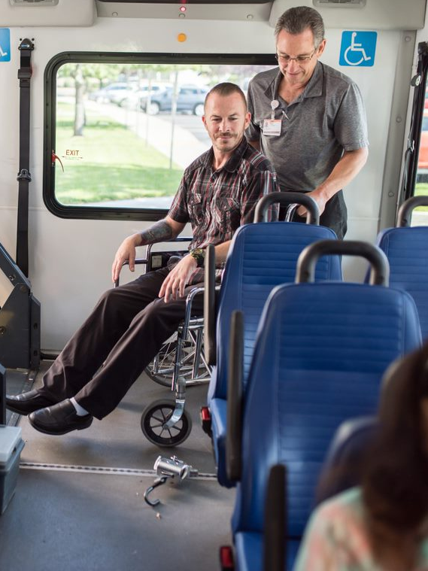
What is a Coordinated Plan?
  Includes an assessment of available transportation providers and population needs.
Is required to be eligible for some Federal Transit Administration (FTA) grant programs.
A list of strategies to improve mobility for transit-dependent residents in the region.
Notes:
The plan is developed through a process that includes representatives of the public transit system, private transportation, non-profit transportation, and human services providers, as well as participation by members of the general public.

Slide 4
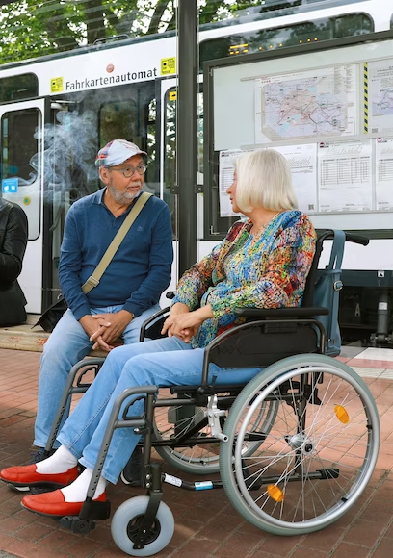
Shasta Coordinated Transportation Plan Goals
Serves as a guide for SRTA, other agencies, and transportation providers to offer better coordination to residents in the Shasta Region.
Allows transportation providers in the Shasta Region to be eligible for FTA Enhanced Mobility for Seniors and Individuals with Disabilities (Section 5310) Program grants.
Notes:
Provide a meaningful document as a guide for SRTA and other transit and human service agencies to offer better coordinated transportation for Shasta County residents. Focusing on older adults (ages 65 and older), people with disabilities, and low-income households.
Develop short-term and long-term implementable strategies which include all types of transportation providers in the region.
Identify a champion or responsible entity for implementing high-priority strategies.
Coordinated strategies aren’t limited to purchasing a van or starting a new program but could be one agency assisting another with grant writing, etc.

Slide 5
Where are we in the plan process?
Technical Memorandum 1 (TM1)
  Demographics Overview
  Regional Plans Summary
  Regional Transportation Service Providers Descriptions
Transportation Provider Questionnaire
Technical Memorandum 2 – (2017 Strategies) completed in August
  Previous Strategies Overview
  Outreach Summary Draft Chapter
SSTAC and Public Workshop to review existing and potential strategies
Up Next: Technical Memorandum 3 –Transportation Needs,
  Duplicative Services, and Recommended Strategies

Slide 6
Shasta Region Demographics
Notes:
There are 32,828 disabled persons in Shasta County (18 percent of the total population). This is also much greater than the statewide average of 11 percent.
It is estimated that 13 percent of the Shasta County population lives below the federal poverty level (as defined by the US Census Bureau). This is just slightly higher than the State of California (12 percent).
One out of every five Shasta County residents is a senior adult over the age of 65 (37,180 persons or 20 percent of the total population). This is much greater than the statewide senior population of 15 percent).
With only half of these senior adults living in Redding (50 percent), the other half of the senior population is dispersed throughout the county.

Slide 7
Transit Needs Index
Notes:
A transit needs index considers the density by demographic population group for each community within a specific region. As shown in the table here, each community receives a 1 (lowest) through 5 (highest) ranking based on the percentage of each demographic within that particular area. These values are then summed to create the overall transit need index ranking throughout the region, as you can see in the final column here.

Slide 8
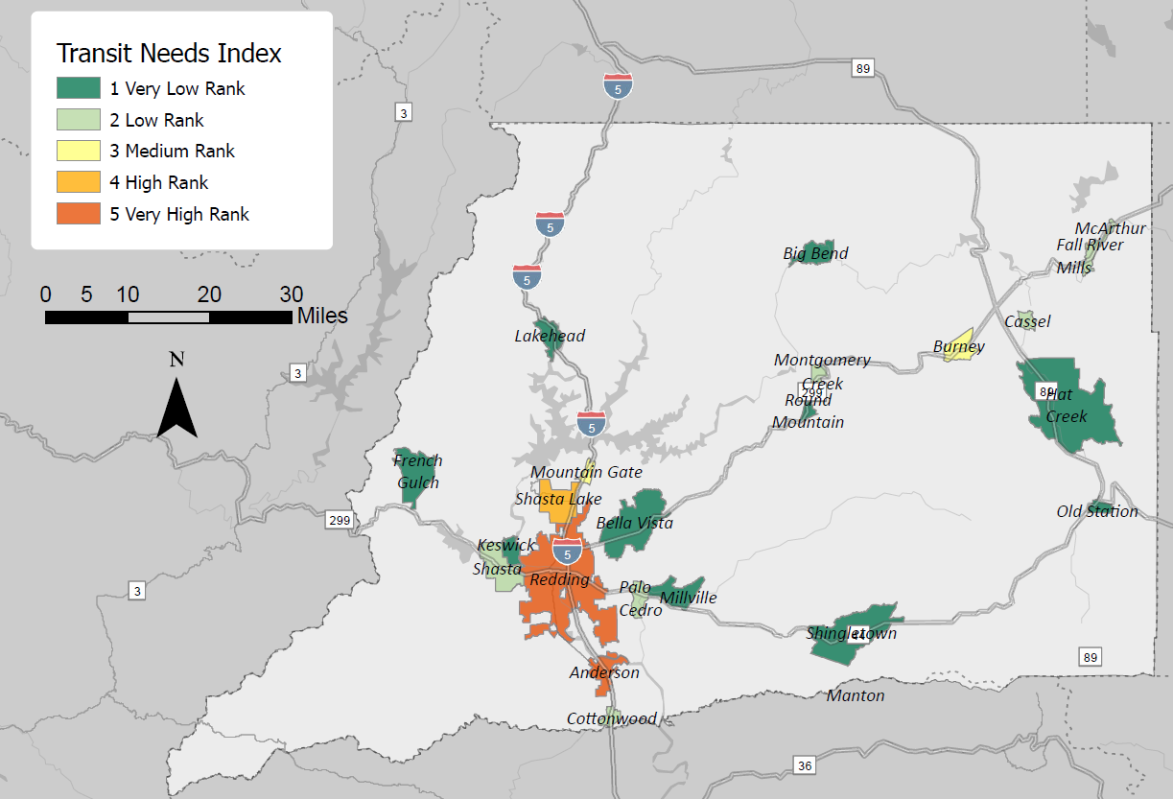
Transit Needs Index Continued…
Notes:
The City of Anderson ranked the highest (24) for the greatest concentration of persons with disabilities, persons below the poverty level, unemployed, and zero-vehicle households.
Redding, Shasta Lake, and Johnson Park also ranked relatively high
Demographics in Burney and Mountain Gate also indicated moderate need for transit services based on the population density of transit dependent residents..

Slide 9
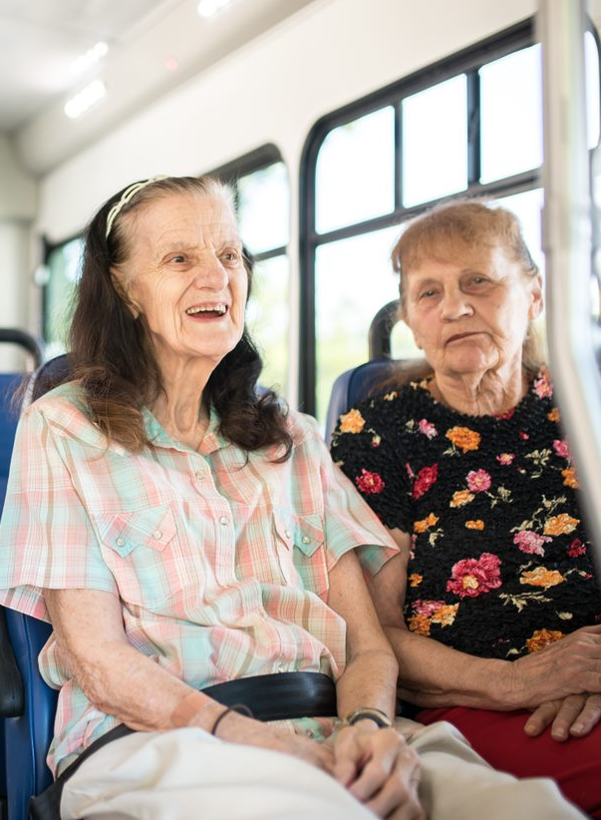
2017 Shasta Coordinated Transportation Plan
Previously Identified Gaps and Challenges
Lack of Sunday transportation services
Challenges to specific service eligibility in smaller communities outside of Redding
RABA service frequency
Schedule/hours of operation
Various Demand Response service challenges, such as the need for advanced scheduling, expensive fares, and eligibility
Knowledge gaps
Lack of interregional services

Slide 10
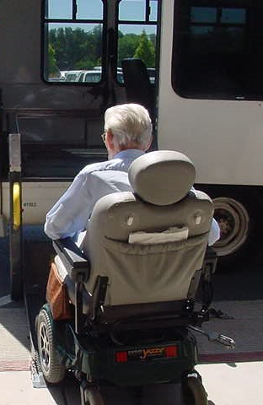
2017 Shasta Coordinated Transportation Plan
Previously Recommended Strategies:
Evaluate, Strengthen, and Maintain Existing Transportation Services/Projects
Marketing and Education of Services
Mobility Management
Multi-Organization Approach to Solutions/Overall Coordination
Driver Recruitment, Development, Screening, and Training Program
New or Expanded Services/Projects to Meet Identified Gaps and Needs
Infrastructure Projects
Shared-Use of Agency Vehicles

Slide 11
Strategic Coordination Categories
Maintain Existing Transportation Services
Increase Cooperation and Coordination Among Transportation Providers
Increase Public Awareness of Available Transportation Resources
Enhance or Expand Transportation Services

Slide 12
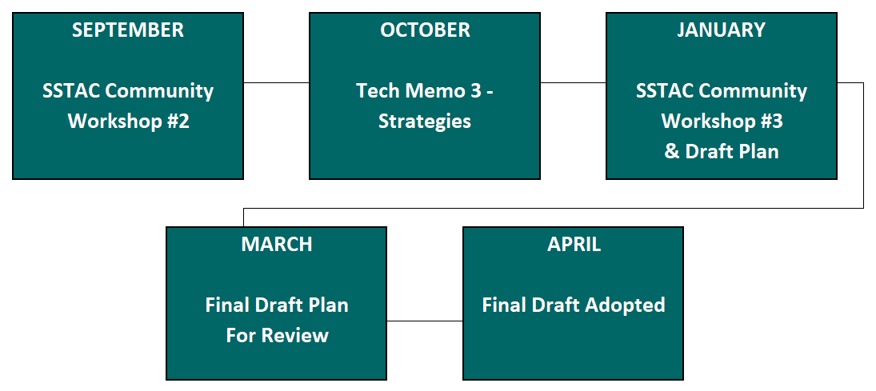
Project Timeline

Slide 13
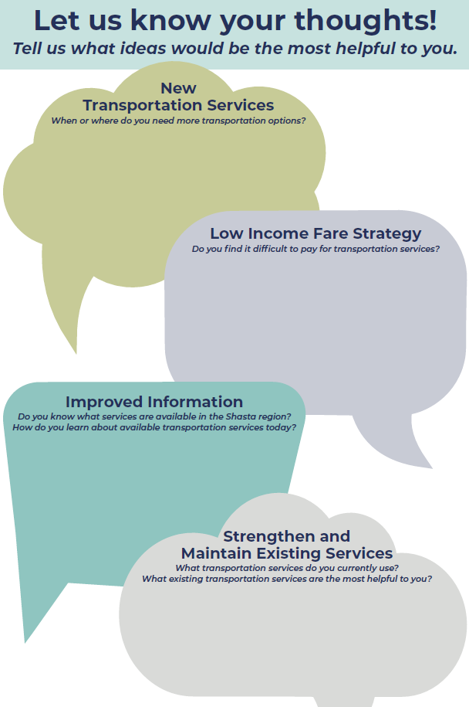
Why are you here today?
We want to hear from you!
Please visit each of our public input stations and let us know what you think.
Fill out a comment card with anything else you wish to add.

Slide 14
Thank you!
Please contact Keith Williams or Laurent Beauregard if you have any further questions or concerns.
Keith Williams
(530) 262-6192
kwilliams@srta.ca.gov
Laurent Beauregard
530-262-6205
lbeauregard@srta.ca.gov

